Slide 1
Georgia IBM Power Users Group
Power Systems Tools You Can Use - An Overview
Chip Layton, Senior IT Specialist
chipl@us.ibm.com
July 27, 2017

Slide 2
Getting the most from your Power environment
Locating issue from the command line
Documenting your environment
Advanced assistance from STG Lab Services
How to quickly review an LPAR with vmstat, mpstat, lparstat and more
Downloadable tools to help you watch record your environment status
PowerCare engagements to improve your command and control

Slide 3
AIX native tools and how to use them

Slide 4
Power system tools you can use
vmstat and CPU

Slide 5
# vmstat 2
System configuration: lcpu=8 mem=4096MB ent=0.50
kthr memory page faults cpu
----- ----------- ------------------------ ------------ -----------------------
r b avm fre re pi po fr sr cy in sy cs us sy id wa pc ec
7 0 504253 512913 0 0 0 0 0 0 947 150858 8812 35 51 13 0 1.90 380.2
3 0 504140 513022 0 0 0 0 0 0 905 151812 8616 35 51 15 0 1.91 381.6
2 0 504126 513036 0 0 0 0 0 0 896 145561 8479 35 50 15 0 1.88 375.1
2 0 503211 513939 0 0 0 0 0 0 877 141824 8626 35 50 15 0 1.83 366.3
2 0 503088 514058 0 0 0 0 0 0 879 150441 8419 36 52 12 0 1.84 367.8
1 0 504051 513108 0 0 0 0 0 0 890 144569 8616 36 51 13 0 1.82 363.8
1 0 504184 512980 0 0 0 0 0 0 947 157045 9394 36 54 10 0 1.86 371.5
2 0 504212 512951 0 0 0 0 0 0 937 149472 8796 36 52 13 0 1.88 376.6
1 0 504180 512986 0 0 0 0 0 0 930 149719 9256 35 52 13 0 1.89 378.8
9 0 504113 513049 0 0 0 0 0 0 861 147474 8045 35 50 15 0 1.85 370.1
19 0 503626 513525 0 0 0 0 0 0 911 147120 8884 36 52 12 0 1.84 367.6
8 0 504549 512603 0 0 0 0 0 0 906 149115 8299 37 53 11 0 1.79 358.9
14 0 504072 513086 0 0 0 0 0 0 927 151875 8584 36 52 12 0 1.86 372.1
10 0 503037 514107 0 0 0 0 0 0 936 146201 8252 35 51 14 0 1.86 371.8
12 0 503444 513703 0 0 0 0 0 0 896 150941 8422 35 51 14 0 1.87 373.2

Slide 6
# vmstat 2
System configuration: lcpu=8 mem=4096MB ent=0.50
kthr memory page faults cpu
----- ----------- ------------------------ ------------ -----------------------
r b avm fre re pi po fr sr cy in sy cs us sy id wa pc ec
7 0 504253 512913 0 0 0 0 0 0 947 150858 8812 35 51 13 0 1.90 380.2
3 0 504140 513022 0 0 0 0 0 0 905 151812 8616 35 51 15 0 1.91 381.6
2 0 504126 513036 0 0 0 0 0 0 896 145561 8479 35 50 15 0 1.88 375.1
2 0 503211 513939 0 0 0 0 0 0 877 141824 8626 35 50 15 0 1.83 366.3
2 0 503088 514058 0 0 0 0 0 0 879 150441 8419 36 52 12 0 1.84 367.8
1 0 504051 513108 0 0 0 0 0 0 890 144569 8616 36 51 13 0 1.82 363.8
1 0 504184 512980 0 0 0 0 0 0 947 157045 9394 36 54 10 0 1.86 371.5
2 0 504212 512951 0 0 0 0 0 0 937 149472 8796 36 52 13 0 1.88 376.6
1 0 504180 512986 0 0 0 0 0 0 930 149719 9256 35 52 13 0 1.89 378.8
9 0 504113 513049 0 0 0 0 0 0 861 147474 8045 35 50 15 0 1.85 370.1
19 0 503626 513525 0 0 0 0 0 0 911 147120 8884 36 52 12 0 1.84 367.6
8 0 504549 512603 0 0 0 0 0 0 906 149115 8299 37 53 11 0 1.79 358.9
14 0 504072 513086 0 0 0 0 0 0 927 151875 8584 36 52 12 0 1.86 372.1
10 0 503037 514107 0 0 0 0 0 0 936 146201 8252 35 51 14 0 1.86 371.8
12 0 503444 513703 0 0 0 0 0 0 896 150941 8422 35 51 14 0 1.87 373.2

Slide 7
# vmstat 2
System configuration: lcpu=8 mem=4096MB ent=0.50
kthr memory page faults cpu
----- ----------- ------------------------ ------------ -----------------------
r b avm fre re pi po fr sr cy in sy cs us sy id wa pc ec
7 0 504253 512913 0 0 0 0 0 0 947 150858 8812 35 51 13 0 1.90 380.2
3 0 504140 513022 0 0 0 0 0 0 905 151812 8616 35 51 15 0 1.91 381.6
2 0 504126 513036 0 0 0 0 0 0 896 145561 8479 35 50 15 0 1.88 375.1
2 0 503211 513939 0 0 0 0 0 0 877 141824 8626 35 50 15 0 1.83 366.3
2 0 503088 514058 0 0 0 0 0 0 879 150441 8419 36 52 12 0 1.84 367.8
1 0 504051 513108 0 0 0 0 0 0 890 144569 8616 36 51 13 0 1.82 363.8
1 0 504184 512980 0 0 0 0 0 0 947 157045 9394 36 54 10 0 1.86 371.5
2 0 504212 512951 0 0 0 0 0 0 937 149472 8796 36 52 13 0 1.88 376.6
1 0 504180 512986 0 0 0 0 0 0 930 149719 9256 35 52 13 0 1.89 378.8
9 0 504113 513049 0 0 0 0 0 0 861 147474 8045 35 50 15 0 1.85 370.1
19 0 503626 513525 0 0 0 0 0 0 911 147120 8884 36 52 12 0 1.84 367.6
8 0 504549 512603 0 0 0 0 0 0 906 149115 8299 37 53 11 0 1.79 358.9
14 0 504072 513086 0 0 0 0 0 0 927 151875 8584 36 52 12 0 1.86 372.1
10 0 503037 514107 0 0 0 0 0 0 936 146201 8252 35 51 14 0 1.86 371.8
12 0 503444 513703 0 0 0 0 0 0 896 150941 8422 35 51 14 0 1.87 373.2

Slide 8
# vmstat 2
System configuration: lcpu=8 mem=4096MB ent=0.50
kthr memory page faults cpu
----- ----------- ------------------------ ------------ -----------------------
r b avm fre re pi po fr sr cy in sy cs us sy id wa pc ec
7 0 504253 512913 0 0 0 0 0 0 947 150858 8812 35 51 13 0 1.90 380.2
3 0 504140 513022 0 0 0 0 0 0 905 151812 8616 35 51 15 0 1.91 381.6
2 0 504126 513036 0 0 0 0 0 0 896 145561 8479 35 50 15 0 1.88 375.1
2 0 503211 513939 0 0 0 0 0 0 877 141824 8626 35 50 15 0 1.83 366.3
2 0 503088 514058 0 0 0 0 0 0 879 150441 8419 36 52 12 0 1.84 367.8
1 0 504051 513108 0 0 0 0 0 0 890 144569 8616 36 51 13 0 1.82 363.8
1 0 504184 512980 0 0 0 0 0 0 947 157045 9394 36 54 10 0 1.86 371.5
2 0 504212 512951 0 0 0 0 0 0 937 149472 8796 36 52 13 0 1.88 376.6
1 0 504180 512986 0 0 0 0 0 0 930 149719 9256 35 52 13 0 1.89 378.8
9 0 504113 513049 0 0 0 0 0 0 861 147474 8045 35 50 15 0 1.85 370.1
19 0 503626 513525 0 0 0 0 0 0 911 147120 8884 36 52 12 0 1.84 367.6
8 0 504549 512603 0 0 0 0 0 0 906 149115 8299 37 53 11 0 1.79 358.9
14 0 504072 513086 0 0 0 0 0 0 927 151875 8584 36 52 12 0 1.86 372.1
10 0 503037 514107 0 0 0 0 0 0 936 146201 8252 35 51 14 0 1.86 371.8
12 0 503444 513703 0 0 0 0 0 0 896 150941 8422 35 51 14 0 1.87 373.2

Slide 9
# vmstat 2
System configuration: lcpu=8 mem=4096MB ent=0.50
kthr memory page faults cpu
----- ----------- ------------------------ ------------ -----------------------
r b avm fre re pi po fr sr cy in sy cs us sy id wa pc ec
7 0 504253 512913 0 0 0 0 0 0 947 150858 8812 35 51 13 0 1.90 380.2
3 0 504140 513022 0 0 0 0 0 0 905 151812 8616 35 51 15 0 1.91 381.6
2 0 504126 513036 0 0 0 0 0 0 896 145561 8479 35 50 15 0 1.88 375.1
2 0 503211 513939 0 0 0 0 0 0 877 141824 8626 35 50 15 0 1.83 366.3
2 0 503088 514058 0 0 0 0 0 0 879 150441 8419 36 52 12 0 1.84 367.8
1 0 504051 513108 0 0 0 0 0 0 890 144569 8616 36 51 13 0 1.82 363.8
1 0 504184 512980 0 0 0 0 0 0 947 157045 9394 36 54 10 0 1.86 371.5
2 0 504212 512951 0 0 0 0 0 0 937 149472 8796 36 52 13 0 1.88 376.6
1 0 504180 512986 0 0 0 0 0 0 930 149719 9256 35 52 13 0 1.89 378.8
9 0 504113 513049 0 0 0 0 0 0 861 147474 8045 35 50 15 0 1.85 370.1
19 0 503626 513525 0 0 0 0 0 0 911 147120 8884 36 52 12 0 1.84 367.6
8 0 504549 512603 0 0 0 0 0 0 906 149115 8299 37 53 11 0 1.79 358.9
14 0 504072 513086 0 0 0 0 0 0 927 151875 8584 36 52 12 0 1.86 372.1
10 0 503037 514107 0 0 0 0 0 0 936 146201 8252 35 51 14 0 1.86 371.8
12 0 503444 513703 0 0 0 0 0 0 896 150941 8422 35 51 14 0 1.87 373.2

Slide 10
# vmstat 2
System configuration: lcpu=8 mem=4096MB ent=0.50
kthr memory page faults cpu
----- ----------- ------------------------ ------------ -----------------------
r b avm fre re pi po fr sr cy in sy cs us sy id wa pc ec
7 0 504253 512913 0 0 0 0 0 0 947 150858 8812 35 51 13 0 1.90 380.2
3 0 504140 513022 0 0 0 0 0 0 905 151812 8616 35 51 15 0 1.91 381.6
2 0 504126 513036 0 0 0 0 0 0 896 145561 8479 35 50 15 0 1.88 375.1
2 0 503211 513939 0 0 0 0 0 0 877 141824 8626 35 50 15 0 1.83 366.3
2 0 503088 514058 0 0 0 0 0 0 879 150441 8419 36 52 12 0 1.84 367.8
1 0 504051 513108 0 0 0 0 0 0 890 144569 8616 36 51 13 0 1.82 363.8
1 0 504184 512980 0 0 0 0 0 0 947 157045 9394 36 54 10 0 1.86 371.5
2 0 504212 512951 0 0 0 0 0 0 937 149472 8796 36 52 13 0 1.88 376.6
1 0 504180 512986 0 0 0 0 0 0 930 149719 9256 35 52 13 0 1.89 378.8
9 0 504113 513049 0 0 0 0 0 0 861 147474 8045 35 50 15 0 1.85 370.1
19 0 503626 513525 0 0 0 0 0 0 911 147120 8884 36 52 12 0 1.84 367.6
8 0 504549 512603 0 0 0 0 0 0 906 149115 8299 37 53 11 0 1.79 358.9
14 0 504072 513086 0 0 0 0 0 0 927 151875 8584 36 52 12 0 1.86 372.1
10 0 503037 514107 0 0 0 0 0 0 936 146201 8252 35 51 14 0 1.86 371.8
12 0 503444 513703 0 0 0 0 0 0 896 150941 8422 35 51 14 0 1.87 373.2
Notes:
CPU: Breakdown of percentage usage of processor time.
us
User time.
If the current physical processor consumption of the uncapped partitions exceeds the entitled capacity, the percentage becomes relative to the number of physical processor consumed (pc).
sy
System time.
If the current physical processor consumption of the uncapped partitions exceeds the entitled capacity, the percentage becomes relative to the number of physical processor consumed (pc).
id
Processor idle time.
If the current physical processor consumption of the uncapped partitions exceeds the entitled capacity, the percentage becomes relative to the number of physical processor consumed (pc).
wa
Processor idle time during which the system had outstanding disk/NFS I/O request. If the current physical processor consumption of the uncapped partitions exceeds the entitled capacity, the percentage becomes relative to the number of physical processor consumed (pc).

Slide 11
Power system tools you can use
vmstat and memory

Slide 12
Basic Memory profile for AIX LPAR
AIX
Computational Memory
There are four types of memory in every LPAR
AIX – Memory required by the operating system
Computational – Memory assigned to user processes
Including shared memory segments
Free – Memory pages available for immediate use
JFS Cache – Memory used to store JFS file data
Free Memory
JFS Cache
Free Memory is actually a list of memory pages that are
immediately available for allocation/assignment upon request;
it is not a list of only contiguous pages. This list is the next
most important memory after Computational Memory.
Remember: “Free Memory drives everything.”

Slide 13
# vmstat 2
System configuration: lcpu=8 mem=4096MB ent=0.50
kthr memory page faults cpu
----- ----------- ------------------------ ------------ -----------------------
r b avm fre re pi po fr sr cy in sy cs us sy id wa pc ec
7 0 504253 512913 0 0 0 0 0 0 947 150858 8812 35 51 13 0 1.90 380.2
3 0 504140 513022 0 0 0 0 0 0 905 151812 8616 35 51 15 0 1.91 381.6
2 0 504126 513036 0 0 0 0 0 0 896 145561 8479 35 50 15 0 1.88 375.1
2 0 503211 513939 0 0 0 0 0 0 877 141824 8626 35 50 15 0 1.83 366.3
2 0 503088 514058 0 0 0 0 0 0 879 150441 8419 36 52 12 0 1.84 367.8
1 0 504051 513108 0 0 0 0 0 0 890 144569 8616 36 51 13 0 1.82 363.8
1 0 504184 512980 0 0 0 0 0 0 947 157045 9394 36 54 10 0 1.86 371.5
2 0 504212 512951 0 0 0 0 0 0 937 149472 8796 36 52 13 0 1.88 376.6
1 0 504180 512986 0 0 0 0 0 0 930 149719 9256 35 52 13 0 1.89 378.8
9 0 504113 513049 0 0 0 0 0 0 861 147474 8045 35 50 15 0 1.85 370.1
19 0 503626 513525 0 0 0 0 0 0 911 147120 8884 36 52 12 0 1.84 367.6
8 0 504549 512603 0 0 0 0 0 0 906 149115 8299 37 53 11 0 1.79 358.9
14 0 504072 513086 0 0 0 0 0 0 927 151875 8584 36 52 12 0 1.86 372.1
10 0 503037 514107 0 0 0 0 0 0 936 146201 8252 35 51 14 0 1.86 371.8
12 0 503444 513703 0 0 0 0 0 0 896 150941 8422 35 51 14 0 1.87 373.2

Slide 14
# vmstat 2
System configuration: lcpu=8 mem=4096MB ent=0.50
kthr memory page faults cpu
----- ----------- ------------------------ ------------ -----------------------
r b avm fre re pi po fr sr cy in sy cs us sy id wa pc ec
7 0 504253 512913 0 0 0 0 0 0 947 150858 8812 35 51 13 0 1.90 380.2
3 0 504140 513022 0 0 0 0 0 0 905 151812 8616 35 51 15 0 1.91 381.6
2 0 504126 513036 0 0 0 0 0 0 896 145561 8479 35 50 15 0 1.88 375.1
2 0 503211 513939 0 0 0 0 0 0 877 141824 8626 35 50 15 0 1.83 366.3
2 0 503088 514058 0 0 0 0 0 0 879 150441 8419 36 52 12 0 1.84 367.8
1 0 504051 513108 0 0 0 0 0 0 890 144569 8616 36 51 13 0 1.82 363.8
1 0 504184 512980 0 0 0 0 0 0 947 157045 9394 36 54 10 0 1.86 371.5
2 0 504212 512951 0 0 0 0 0 0 937 149472 8796 36 52 13 0 1.88 376.6
1 0 504180 512986 0 0 0 0 0 0 930 149719 9256 35 52 13 0 1.89 378.8
9 0 504113 513049 0 0 0 0 0 0 861 147474 8045 35 50 15 0 1.85 370.1
19 0 503626 513525 0 0 0 0 0 0 911 147120 8884 36 52 12 0 1.84 367.6
8 0 504549 512603 0 0 0 0 0 0 906 149115 8299 37 53 11 0 1.79 358.9
14 0 504072 513086 0 0 0 0 0 0 927 151875 8584 36 52 12 0 1.86 372.1
10 0 503037 514107 0 0 0 0 0 0 936 146201 8252 35 51 14 0 1.86 371.8
12 0 503444 513703 0 0 0 0 0 0 896 150941 8422 35 51 14 0 1.87 373.2

Slide 15
# vmstat 2
System configuration: lcpu=8 mem=4096MB ent=0.50
kthr memory page faults cpu
----- ----------- ------------------------ ------------ -----------------------
r b avm fre re pi po fr sr cy in sy cs us sy id wa pc ec
7 0 504253 512913 0 0 0 0 0 0 947 150858 8812 35 51 13 0 1.90 380.2
3 0 504140 513022 0 0 0 0 0 0 905 151812 8616 35 51 15 0 1.91 381.6
2 0 504126 513036 0 0 0 0 0 0 896 145561 8479 35 50 15 0 1.88 375.1
2 0 503211 513939 0 0 0 0 0 0 877 141824 8626 35 50 15 0 1.83 366.3
2 0 503088 514058 0 0 0 0 0 0 879 150441 8419 36 52 12 0 1.84 367.8
1 0 504051 513108 0 0 0 0 0 0 890 144569 8616 36 51 13 0 1.82 363.8
1 0 504184 512980 0 0 0 0 0 0 947 157045 9394 36 54 10 0 1.86 371.5
2 0 504212 512951 0 0 0 0 0 0 937 149472 8796 36 52 13 0 1.88 376.6
1 0 504180 512986 0 0 0 0 0 0 930 149719 9256 35 52 13 0 1.89 378.8
9 0 504113 513049 0 0 0 0 0 0 861 147474 8045 35 50 15 0 1.85 370.1
19 0 503626 513525 0 0 0 0 0 0 911 147120 8884 36 52 12 0 1.84 367.6
8 0 504549 512603 0 0 0 0 0 0 906 149115 8299 37 53 11 0 1.79 358.9
14 0 504072 513086 0 0 0 0 0 0 927 151875 8584 36 52 12 0 1.86 372.1
10 0 503037 514107 0 0 0 0 0 0 936 146201 8252 35 51 14 0 1.86 371.8
12 0 503444 513703 0 0 0 0 0 0 896 150941 8422 35 51 14 0 1.87 373.2

Slide 16
Power system tools you can use
vmstat and I/O

Slide 17
# vmstat 2
System configuration: lcpu=8 mem=4096MB ent=0.50
kthr memory page faults cpu
----- ----------- ------------------------ ------------ -----------------------
r b avm fre re pi po fr sr cy in sy cs us sy id wa pc ec
7 0 504253 512913 0 0 0 0 0 0 947 150858 8812 35 51 13 0 1.90 380.2
3 0 504140 513022 0 0 0 0 0 0 905 151812 8616 35 51 15 0 1.91 381.6
2 0 504126 513036 0 0 0 0 0 0 896 145561 8479 35 50 15 0 1.88 375.1
2 0 503211 513939 0 0 0 0 0 0 877 141824 8626 35 50 15 0 1.83 366.3
2 0 503088 514058 0 0 0 0 0 0 879 150441 8419 36 52 12 0 1.84 367.8
1 0 504051 513108 0 0 0 0 0 0 890 144569 8616 36 51 13 0 1.82 363.8
1 0 504184 512980 0 0 0 0 0 0 947 157045 9394 36 54 10 0 1.86 371.5
2 0 504212 512951 0 0 0 0 0 0 937 149472 8796 36 52 13 0 1.88 376.6
1 0 504180 512986 0 0 0 0 0 0 930 149719 9256 35 52 13 0 1.89 378.8
9 0 504113 513049 0 0 0 0 0 0 861 147474 8045 35 50 15 0 1.85 370.1
19 0 503626 513525 0 0 0 0 0 0 911 147120 8884 36 52 12 0 1.84 367.6
8 0 504549 512603 0 0 0 0 0 0 906 149115 8299 37 53 11 0 1.79 358.9
14 0 504072 513086 0 0 0 0 0 0 927 151875 8584 36 52 12 0 1.86 372.1
10 0 503037 514107 0 0 0 0 0 0 936 146201 8252 35 51 14 0 1.86 371.8
12 0 503444 513703 0 0 0 0 0 0 896 150941 8422 35 51 14 0 1.87 373.2

Slide 18
# vmstat 2
System configuration: lcpu=8 mem=4096MB ent=0.50
kthr memory page faults cpu
----- ----------- ------------------------ ------------ -----------------------
r b avm fre re pi po fr sr cy in sy cs us sy id wa pc ec
7 0 504253 512913 0 0 0 0 0 0 947 150858 8812 35 51 13 0 1.90 380.2
3 0 504140 513022 0 0 0 0 0 0 905 151812 8616 35 51 15 0 1.91 381.6
2 0 504126 513036 0 0 0 0 0 0 896 145561 8479 35 50 15 0 1.88 375.1
2 0 503211 513939 0 0 0 0 0 0 877 141824 8626 35 50 15 0 1.83 366.3
2 0 503088 514058 0 0 0 0 0 0 879 150441 8419 36 52 12 0 1.84 367.8
1 0 504051 513108 0 0 0 0 0 0 890 144569 8616 36 51 13 0 1.82 363.8
1 0 504184 512980 0 0 0 0 0 0 947 157045 9394 36 54 10 0 1.86 371.5
2 0 504212 512951 0 0 0 0 0 0 937 149472 8796 36 52 13 0 1.88 376.6
1 0 504180 512986 0 0 0 0 0 0 930 149719 9256 35 52 13 0 1.89 378.8
9 0 504113 513049 0 0 0 0 0 0 861 147474 8045 35 50 15 0 1.85 370.1
19 0 503626 513525 0 0 0 0 0 0 911 147120 8884 36 52 12 0 1.84 367.6
8 0 504549 512603 0 0 0 0 0 0 906 149115 8299 37 53 11 0 1.79 358.9
14 0 504072 513086 0 0 0 0 0 0 927 151875 8584 36 52 12 0 1.86 372.1
10 0 503037 514107 0 0 0 0 0 0 936 146201 8252 35 51 14 0 1.86 371.8
12 0 503444 513703 0 0 0 0 0 0 896 150941 8422 35 51 14 0 1.87 373.2

Slide 19
# vmstat 2
System configuration: lcpu=8 mem=4096MB ent=0.50
kthr memory page faults cpu
----- ----------- ------------------------ ------------ -----------------------
r b avm fre re pi po fr sr cy in sy cs us sy id wa pc ec
7 0 504253 512913 0 0 0 0 0 0 947 150858 8812 35 51 13 0 1.90 380.2
3 0 504140 513022 0 0 0 0 0 0 905 151812 8616 35 51 15 0 1.91 381.6
2 0 504126 513036 0 0 0 0 0 0 896 145561 8479 35 50 15 0 1.88 375.1
2 0 503211 513939 0 0 0 0 0 0 877 141824 8626 35 50 15 0 1.83 366.3
2 0 503088 514058 0 0 0 0 0 0 879 150441 8419 36 52 12 0 1.84 367.8
1 0 504051 513108 0 0 0 0 0 0 890 144569 8616 36 51 13 0 1.82 363.8
1 0 504184 512980 0 0 0 0 0 0 947 157045 9394 36 54 10 0 1.86 371.5
2 0 504212 512951 0 0 0 0 0 0 937 149472 8796 36 52 13 0 1.88 376.6
1 0 504180 512986 0 0 0 0 0 0 930 149719 9256 35 52 13 0 1.89 378.8
9 0 504113 513049 0 0 0 0 0 0 861 147474 8045 35 50 15 0 1.85 370.1
19 0 503626 513525 0 0 0 0 0 0 911 147120 8884 36 52 12 0 1.84 367.6
8 0 504549 512603 0 0 0 0 0 0 906 149115 8299 37 53 11 0 1.79 358.9
14 0 504072 513086 0 0 0 0 0 0 927 151875 8584 36 52 12 0 1.86 372.1
10 0 503037 514107 0 0 0 0 0 0 936 146201 8252 35 51 14 0 1.86 371.8
12 0 503444 513703 0 0 0 0 0 0 896 150941 8422 35 51 14 0 1.87 373.2

Slide 20
Going deep with AIX commands
Configuration and long term perfmance statistics

Slide 21
(0) root @ thufir-lp14: /data
# lparstat -i
Node Name : thufir-lp14
Partition Name : thufir-lp14
Partition Number : 114
Type : Shared-SMT-4
Mode : Uncapped
Entitled Capacity : 0.50
Partition Group-ID : 32882
Shared Pool ID : 0
Online Virtual CPUs : 2
Maximum Virtual CPUs : 4
Minimum Virtual CPUs : 1
Online Memory : 4096 MB
Maximum Memory : 6144 MB
Minimum Memory : 3072 MB
Variable Capacity Weight : 128
Minimum Capacity : 0.10
Maximum Capacity : 1.00
Capacity Increment : 0.01
Maximum Physical CPUs in system : 48
Active Physical CPUs in system : 48
Active CPUs in Pool : 34
Shared Physical CPUs in system : 34

Slide 22
Maximum Capacity of Pool : 3400
Entitled Capacity of Pool : 950
Unallocated Capacity : 0.00
Physical CPU Percentage : 25.00%
Unallocated Weight : 0
Memory Mode : Dedicated
Total I/O Memory Entitlement : -
Variable Memory Capacity Weight : -
Memory Pool ID : -
Physical Memory in the Pool : -
Hypervisor Page Size : -
Unallocated Variable Memory Capacity Weight: -
Unallocated I/O Memory entitlement : -
Memory Group ID of LPAR : -
Desired Virtual CPUs : 2
Desired Memory : 4096 MB
Desired Variable Capacity Weight : 128
Desired Capacity : 0.50
Target Memory Expansion Factor : -
Target Memory Expansion Size : -
Power Saving Mode : Disabled
Sub Processor Mode : -

Slide 23
uptime ; vmstat –s
07:45AM up 5 days, 14:35, 7 users, load average: 68.90, 55.77, 53.68
13783904583 total address trans. faults
18464514733 page ins
2091137989 page outs
0 paging space page ins
0 paging space page outs ← Acceptable Tolerance is 5-digits/90days Uptime
0 total reclaims
6953205800 zero filled pages faults
89715 executable filled pages faults
38420778917 pages examined by clock
5 revolutions of the clock hand
20036911968 pages freed by the clock
46545239 backtracks
137657525 free frame waits ← Acceptable Tolerance is 5-digits/90days Uptime
0 extend XPT waits
1779946655 pending I/O waits
20598490595 start I/Os
2333693437 iodones
8560316549 cpu context switches
1900589120 device interrupts
70007091 software interrupts
1230095024 decrementer interrupts
7598754 mpc-sent interrupts
7598754 mpc-received interrupts
676750577 phantom interrupts
0 traps
32508428126 syscalls

Slide 24
AIX:vmstat –v
25165824 memory pages
19112512 lruable pages
9201 free pages ← This is the number of Free Pages on the Free Memory list
4 memory pools ← The count of AIX logical memory pools
8028287 pinned pages ← Generally AIX is comprised of only pinned memory pages
80.0 maxpin percentage
3.0 minperm percentage ← This value is the trigger for pagingspace-pageouts
90.0 maxperm percentage
75.8 numperm percentage ← This is the percent of JFS/JFS2/NFS/VxFS File Cache
14492435 file pages ← This is the number of JFS/JFS2/NFS/VxFS File Cache pages
0.0 compressed percentage
0 compressed pages
75.8 numclient percentage ← This is the percent of JFS2-only File Cache
90.0 maxclient percentage
14492435 client pages ← This is the number of JFS2 File Cache pages
0 remote pageouts scheduled
857 pending disk I/Os blocked with no pbuf ← AIX pbuf exhaustion
0 paging space I/Os blocked with no psbuf ← AIX psbuf exhaustion
1972 filesystem I/Os blocked with no fsbuf ← AIX fsbuf exhaustion (JFS)
9900 client filesystem I/Os blocked with no fsbuf ← AIX fsbuf exhaustion (NFS)
209695 external pager filesystem I/Os blocked with no fsbuf ← AIX fsbuf exhaustion
42.4 percentage of memory used for computational pages

Slide 25
AIX:vmstat –v
25165824 memory pages
19112512 lruable pages
9201 free pages ← This is the number of Free Pages on the Free Memory list
4 memory pools
8028287 pinned pages ← Generally AIX is comprised of only pinned memory pages
80.0 maxpin percentage
3.0 minperm percentage
90.0 maxperm percentage
75.8 numperm percentage
14492435 file pages
0.0 compressed percentage
0 compressed pages
75.8 numclient percentage
90.0 maxclient percentage
14492435 client pages
0 remote pageouts scheduled
857 pending disk I/Os blocked with no pbuf
0 paging space I/Os blocked with no psbuf
1972 filesystem I/Os blocked with no fsbuf
9900 client filesystem I/Os blocked with no fsbuf
209695 external pager filesystem I/Os blocked with no fsbuf
42.4 percentage of memory used for computational pages ← aka COMP%

Slide 26
Looking at Storage

Slide 27
# iostat -m
System configuration: lcpu=8 drives=5 ent=0.50 paths=20 vdisks=0
tty: tin tout avg-cpu: % user % sys % idle % iowait physc % entc
0.2 58.4 2.6 4.1 93.2 0.1 0.1 12.1
Disks: % tm_act Kbps tps Kb_read Kb_wrtn
hdisk0 6.2 141.7 18.0 176635 160252
Paths: % tm_act Kbps tps Kb_read Kb_wrtn
Path1 0.0 0.0 0.0 0 0
Path0 6.1 141.7 18.1 176635 160252
Path3 0.0 0.0 0.0 0 0
Path2 0.0 0.0 0.0 0 0

Slide 28
# iostat -a
System configuration: lcpu=8 drives=5 ent=0.50 paths=20 vdisks=0 tapes=0
tty: tin tout avg-cpu: % user % sys % idle % iowait physc % entc
0.2 60.0 2.5 3.8 93.6 0.1 0.1 11.5
Adapter: Kbps tps Kb_read Kb_wrtn
fcs0 152.1 17.6 185604 135232
Disks: % tm_act Kbps tps Kb_read Kb_wrtn
hdisk4 0.0 0.0 0.0 0 0
hdisk1 0.0 0.0 0.0 0 0
hdisk0 5.5 147.8 17.4 176635 134996
hdisk2 0.0 0.0 0.0 0 0
hdisk3 0.0 4.4 0.2 8969 236
Adapter: Kbps tps Kb_read Kb_wrtn
fcs1 0.0 0.0 0 0
Disks: % tm_act Kbps tps Kb_read Kb_wrtn
hdisk4 0.0 0.0 0.0 0 0
hdisk1 0.0 0.0 0.0 0 0
hdisk0 0.0 0.0 0.0 0 0
hdisk2 0.0 0.0 0.0 0 0
hdisk3 0.0 0.0 0.0 0 0

Slide 29
# iostat -DRTl 10 4
System configuration: lcpu=8 drives=5 paths=20 vdisks=0
Disks: xfers read write queue time
--------------- -------------------------------- ------------------------------------ ------------------------------------ -------------------------------------- ---------
%tm bps tps bread bwrtn rps avg min max time fail wps avg min max time fail avg min max avg avg serv
act serv serv serv outs serv serv serv outs time time time wqsz sqsz qfull
hdisk4 0.0 0.0 0.0 0.0 0.0 0.0 0.0 0.0 0.0 0 0 0.0 0.0 0.0 0.0 0 0 0.0 0.0 0.0 0.0 0.0 0.0 20:00:14
hdisk1 0.0 0.0 0.0 0.0 0.0 0.0 0.0 0.0 0.0 0 0 0.0 0.0 0.0 0.0 0 0 0.0 0.0 0.0 0.0 0.0 0.0 20:00:14
hdisk0 10.5 95.4K 23.3 0.0 95.4K 0.0 0.0 0.0 0.0 0 0 23.3 2.3 0.2 7.8 0 0 0.0 0.0 0.0 0.0 0.0 0.0 20:00:14
hdisk2 0.0 0.0 0.0 0.0 0.0 0.0 0.0 0.0 0.0 0 0 0.0 0.0 0.0 0.0 0 0 0.0 0.0 0.0 0.0 0.0 0.0 20:00:14
hdisk3 0.0 0.0 0.0 0.0 0.0 0.0 0.0 0.0 0.0 0 0 0.0 0.0 0.0 0.0 0 0 0.0 0.0 0.0 0.0 0.0 0.0 20:00:14

Slide 30
lvmo –v rootvg
vgname = rootvg
pv_pbuf_count = 512
total_vg_pbufs = 1024
max_vg_pbufs = 16384
pervg_blocked_io_count = 0
pv_min_pbuf = 512
max_vg_pbuf_count = 0
global_blocked_io_count = 0
aio_cache_pbuf_count = 0
workQ_size = 256

Slide 31
Network performance

Slide 32
fcstat –e fcs0
FIBRE CHANNEL STATISTICS REPORT: fcs0
Device Type: FC Adapter (adapter/vdevice/IBM,vfc-client)
Serial Number: UNKNOWN
Option ROM Version: UNKNOWN
ZA: UNKNOWN
World Wide Node Name: 0xC0507608F22E0129
World Wide Port Name: 0xC0507608F22E0129
FC-4 TYPES:
Supported: 0x0000010000000000000000000000000000000000000000000000000000000000
Active: 0x0000010000000000000000000000000000000000000000000000000000000000
FC-4 TYPES (ULP mappings):
Supported ULPs:
Small Computer System Interface (SCSI) Fibre Channel Protocol (FCP)
Active ULPs:
Small Computer System Interface (SCSI) Fibre Channel Protocol (FCP)
Class of Service: 3
Port Speed (supported): UNKNOWN
Port Speed (running): 16 GBIT
Port FC ID: 0x700096
Port Type: Fabric
Attention Type: UNKNOWN
Topology: UNKNOWN

Slide 33
Seconds Since Last Reset: 5768775
Transmit Statistics Receive Statistics
------------------- ------------------
Frames: -1 -1
Words: -1 -1
LIP Count: -1
NOS Count: -1
Error Frames: -1
Dumped Frames: -1
Link Failure Count: -1
Loss of Sync Count: -1
Loss of Signal: -1
Primitive Seq Protocol Error Count: -1
Invalid Tx Word Count: -1
Invalid CRC Count: -1
IP over FC Adapter Driver Information
No DMA Resource Count: 7154200
No Adapter Elements Count: 0
FC SCSI Adapter Driver Information
No DMA Resource Count: 7154200
No Adapter Elements Count: 0
No Command Resource Count: 0

Slide 34
IP over FC Traffic Statistics
Input Requests: 0
Output Requests: 0
Control Requests: 0
Input Bytes: 0
Output Bytes: 0
FC SCSI Traffic Statistics
Input Requests: 4559462957
Output Requests: 1042851692
Control Requests: 43452975
Input Bytes: 156485244564683
Output Bytes: 48076434451168
Adapter Effective max transfer value: 0x100000

Slide 35
Entstat –d ent0
ETHERNET STATISTICS (ent0) :
Device Type: Virtual I/O Ethernet Adapter (l-lan)
Hardware Address: 52:52:8d:ab:ac:0c
Elapsed Time: 82 days 16 hours 53 minutes 49 seconds
Transmit Statistics: Receive Statistics:
-------------------- -------------------
Packets: 152525438 Packets: 91794786
Bytes: 224931352180 Bytes: 8388302875
Interrupts: 0 Interrupts: 51602194
Transmit Errors: 0 Receive Errors: 0
Packets Dropped: 0 Packets Dropped: 0
Bad Packets: 0
Max Packets on S/W Transmit Queue: 0
S/W Transmit Queue Overflow: 0
Current S/W+H/W Transmit Queue Length: 0

Slide 36
Broadcast Packets: 93748 Broadcast Packets: 18506591
Multicast Packets: 2 Multicast Packets: 264
No Carrier Sense: 0 CRC Errors: 0
DMA Underrun: 0 DMA Overrun: 0
Lost CTS Errors: 0 Alignment Errors: 0
Max Collision Errors: 0 No Resource Errors: 0
Late Collision Errors: 0 Receive Collision Errors: 0
Deferred: 0 Packet Too Short Errors: 0
SQE Test: 0 Packet Too Long Errors: 0
Timeout Errors: 0 Packets Discarded by Adapter: 0
Single Collision Count: 0 Receiver Start Count: 0
Multiple Collision Count: 0
Current HW Transmit Queue Length: 0

Slide 37
General Statistics:
-------------------
No mbuf Errors: 0
Adapter Reset Count: 0
Adapter Data Rate: 20000
Driver Flags: Up Broadcast Running
Simplex 64BitSupport ChecksumOffload
LargeSend DataRateSet VIOENT
IPV6_LSO

Slide 38
entstat –all ent18
ETHERNET STATISTICS (ent18) :
Device Type: Shared Ethernet Adapter
Hardware Address: 98:be:94:68:a2:ba
Elapsed Time: 0 days 8 hours 20 minutes 22 seconds
Transmit Statistics: Receive Statistics:
-------------------- -------------------
Packets: 0 Packets: 95859
Bytes: 0 Bytes: 6715299
Interrupts: 0 Interrupts: 95773
Transmit Errors: 0 Receive Errors: 0
Packets Dropped: 0 Packets Dropped: 0
Bad Packets: 0
Max Packets on S/W Transmit Queue: 0
S/W Transmit Queue Overflow: 0
Current S/W+H/W Transmit Queue Length: 0

Slide 39
Elapsed Time: 0 days 0 hours 0 minutes 0 seconds
Broadcast Packets: 0 Broadcast Packets: 76546
Multicast Packets: 0 Multicast Packets: 16316
No Carrier Sense: 0 CRC Errors: 0
DMA Underrun: 0 DMA Overrun: 0
Lost CTS Errors: 0 Alignment Errors: 0
Max Collision Errors: 0 No Resource Errors: 0
Late Collision Errors: 0 Receive Collision Errors: 0
Deferred: 0 Packet Too Short Errors: 0
SQE Test: 0 Packet Too Long Errors: 0
Timeout Errors: 0 Packets Discarded by Adapter: 0
Single Collision Count: 0 Receiver Start Count: 0
Multiple Collision Count: 0
Current HW Transmit Queue Length: 0

Slide 40
General Statistics:
-------------------
No mbuf Errors: 0
Adapter Reset Count: 0
Adapter Data Rate: 0
Driver Flags: Up Broadcast Running
Simplex 64BitSupport ChecksumOffload
LargeSend DataRateSet

Slide 41
--------------------------------------------------------------
Statistics for adapters in the Shared Ethernet Adapter ent18
--------------------------------------------------------------
Number of adapters: 2
SEA Flags: 00000123
< THREAD >
< LARGESEND >
< ACCOUNTING >
VLAN Ids :
ent9: 501
Real Side Statistics:
Packets received: 95859
Packets bridged: 0
Packets consumed: 95859
Packets fragmented: 0
Packets transmitted: 0
Packets dropped: 0
Packets filtered(VlanId): 0
Packets filtered(Reserved address): 0
Virtual Side Statistics:
Packets received: 0
Packets bridged: 0
Packets consumed: 0
Packets fragmented: 0
Packets transmitted: 0
Packets dropped: 0
Packets filtered(VlanId): 0

Slide 42
High Availability Statistics:
Control Channel PVID: 502
Control Packets in: 123895
Control Packets out: 0
Type of Packets Received:
Keep-Alive Packets: 99922
Recovery Packets: 0
Notify Packets: 0
Limbo Packets: 0
State: BACKUP
Bridge Mode: None
Number of Times Server became Backup: 0
Number of Times Server became Primary: 0
High Availability Mode: Auto
Priority: 4

Slide 43
--------------------------------------------------------------
Real Adapter: ent2
ETHERNET STATISTICS (ent2) :
Device Type: PCIe2 4-Port Adapter (1GbE RJ45) (e4148a1614109404)
Transmit Statistics: Receive Statistics:
-------------------- -------------------
Packets: 0 Packets: 95859
Bytes: 0 Bytes: 6715299
Interrupts: 0 Interrupts: 95773
Transmit Errors: 0 Receive Errors: 0
Packets Dropped: 0 Packets Dropped: 0
Bad Packets: 0
Max Packets on S/W Transmit Queue: 0
S/W Transmit Queue Overflow: 0
Current S/W+H/W Transmit Queue Length: 0

Slide 44
Broadcast Packets: 0 Broadcast Packets: 76546
Multicast Packets: 0 Multicast Packets: 16316
No Carrier Sense: 0 CRC Errors: 0
DMA Underrun: 0 DMA Overrun: 0
Lost CTS Errors: 0 Alignment Errors: 0
Max Collision Errors: 0 No Resource Errors: 0
Late Collision Errors: 0 Receive Collision Errors: 0
Deferred: 0 Packet Too Short Errors: 0
SQE Test: 0 Packet Too Long Errors: 0
Timeout Errors: 0 Packets Discarded by Adapter: 0
Single Collision Count: 0 Receiver Start Count: 0
Multiple Collision Count: 0
Current HW Transmit Queue Length: 0

Slide 45
General Statistics:
-------------------
No mbuf Errors: 0
Adapter Reset Count: 0
Adapter Data Rate: 2000
Driver Flags: Up Broadcast Running
Simplex Promiscuous 64BitSupport
ChecksumOffload LargeSend DataRateSet
PCIe2 4-Port Adapter (1GbE RJ45) (e4148a1614109404)
-------------------------------------------------------------

Slide 46
--------------------------------------------------------------
Virtual Adapter: ent9
ETHERNET STATISTICS (ent9) :
Device Type: Virtual I/O Ethernet Adapter (l-lan)
Hardware Address: 52:52:8d:86:e1:0c
Transmit Statistics: Receive Statistics:
-------------------- -------------------
Packets: 0 Packets: 0
Bytes: 0 Bytes: 0
Interrupts: 0 Interrupts: 0
Transmit Errors: 0 Receive Errors: 0
Packets Dropped: 0 Packets Dropped: 0
Bad Packets: 0
Max Packets on S/W Transmit Queue: 0
S/W Transmit Queue Overflow: 0
Current S/W+H/W Transmit Queue Length: 0

Slide 47
Broadcast Packets: 0 Broadcast Packets: 0
Multicast Packets: 0 Multicast Packets: 0
No Carrier Sense: 0 CRC Errors: 0
DMA Underrun: 0 DMA Overrun: 0
Lost CTS Errors: 0 Alignment Errors: 0
Max Collision Errors: 0 No Resource Errors: 0
Late Collision Errors: 0 Receive Collision Errors: 0
Deferred: 0 Packet Too Short Errors: 0
SQE Test: 0 Packet Too Long Errors: 0
Timeout Errors: 0 Packets Discarded by Adapter: 0
Single Collision Count: 0 Receiver Start Count: 0
Multiple Collision Count: 0
Current HW Transmit Queue Length: 0

Slide 48
General Statistics:
-------------------
No mbuf Errors: 0
Adapter Reset Count: 0
Adapter Data Rate: 20000
Driver Flags: Up Broadcast Running
Simplex Promiscuous AllMulticast
64BitSupport ChecksumOffload LargeSend DataRateSet

Slide 49
Not Idle doesn’t
mean busy

Slide 50
mpstat -a 2
cpu min maj mpcs mpcr dev soft dec ph cs ics bound rq push S3pull S3grd S0rd S1rd S2rd S3rd S4rd S5rd sysc us sy wa id pc %ec ilcs vlcs S3hrd S4hrd S5hrd
0 33865 0 0 0 34 61 320 0 629 348 1 1 0 0 0 100.0 0.0 0.0 0.0 0.0 0.0 24344 39.4 59.8 0.0 0.8 0.29 58.0 52 310 100.0 0.0 0.0
1 0 0 0 0 34 0 9 0 0 0 0 0 0 0 0 - - - - - - 0 0.0 0.5 0.0 99.5 0.07 13.6 0 44 - - -
2 0 0 0 0 33 0 9 0 0 0 0 0 0 0 0 - - - - - - 0 0.0 0.6 0.0 99.4 0.07 13.7 0 42 - - -
3 0 0 0 0 32 0 9 0 0 0 0 0 0 0 0 - - - - - - 0 0.0 0.6 0.0 99.4 0.07 13.7 0 42 - - -
4 0 0 0 0 34 0 16 0 0 0 0 0 0 0 0 - - - - - - 0 0.0 55.9 0.0 44.1 0.00 0.1 0 51 - - -
ALL 33865 0 0 0 167 61 363 0 629 348 1 1 0 0 0 100.0 0.0 0.0 0.0 0.0 0.0 24344 22.9 35.0 0.0 42.2 0.50 99.1 52 489 100.0 0.0 0.0
----------------------------------------------------------------------------------------------------------------------------------------------------------------------------------------------------------------------------------------------
0 16730 0 0 0 17 29 161 0 317 175 1 2 0 0 0 100.0 0.0 0.0 0.0 0.0 0.0 11927 39.4 59.8 0.0 0.8 0.28 57.0 25 148 100.0 0.0 0.0
1 0 0 0 0 16 0 5 0 0 0 0 0 0 0 0 - - - - - - 0 0.0 0.5 0.0 99.5 0.07 13.5 0 21 - - -
2 0 0 0 0 16 0 5 0 0 0 0 0 0 0 0 - - - - - - 0 0.0 0.6 0.0 99.4 0.07 13.5 0 21 - - -
3 0 0 0 0 16 0 5 0 0 0 0 0 0 0 0 - - - - - - 0 0.0 0.6 0.0 99.4 0.07 13.5 0 21 - - -
4 0 0 0 0 17 0 8 0 0 0 0 0 0 0 0 - - - - - - 0 0.0 53.3 0.0 46.7 0.00 0.1 0 25 - - -
5 0 0 0 0 0 0 0 0 0 0 0 0 0 0 0 - - - - - - 0 0.0 0.3 0.0 99.7 0.00 0.1 0 0 - - -
6 0 0 0 0 0 0 0 0 0 0 0 0 0 0 0 - - - - - - 0 0.0 0.3 0.0 99.7 0.00 0.1 0 0 - - -
7 0 0 0 0 0 0 0 0 0 0 0 0 0 0 0 - - - - - - 0 0.0 0.4 0.0 99.6 0.00 0.1 0 0 - - -
U - - - - - - - - - - - - - - - - - - - - - - - - 0.0 71.5 0.25 50.9 - - - - -
ALL 16730 0 0 0 82 29 184 0 317 175 1 2 0 0 0 100.0 0.0 0.0 0.0 0.0 0.0 11927 11.3 17.3 0.0 71.5 0.49 97.7 25 236 100.0 0.0 0.0
----------------------------------------------------------------------------------------------------------------------------------------------------------------------------------------------------------------------------------------------
0 34843 0 0 0 31 59 320 0 687 388 1 3 0 0 0 100.0 0.0 0.0 0.0 0.0 0.0 26261 39.4 59.9 0.0 0.7 0.30 58.6 54 266 100.0 0.0 0.0
1 0 0 0 0 32 0 9 0 0 0 0 0 0 0 0 - - - - - - 0 0.0 0.5 0.0 99.5 0.07 13.7 0 42 - - -
2 0 0 0 0 31 0 9 0 0 0 0 0 0 0 0 - - - - - - 0 0.0 0.5 0.0 99.5 0.07 13.8 0 41 - - -
3 0 0 0 0 31 0 9 0 0 0 0 0 0 0 0 - - - - - - 0 0.0 0.5 0.0 99.5 0.07 13.7 0 41 - - -
4 0 0 0 0 31 0 16 0 0 0 0 0 0 0 0 - - - - - - 0 0.0 54.4 0.0 45.6 0.00 0.1 0 48 - - -
ALL 34843 0 0 0 156 59 363 0 687 388 1 3 0 0 0 100.0 0.0 0.0 0.0 0.0 0.0 26261 23.1 35.4 0.0 41.5 0.51 102.6 54 438 100.0 0.0 0.0
----------------------------------------------------------------------------------------------------------------------------------------------------------------------------------------------------------------------------------------------
Notes:
S0rd same Logical processor/CPU core thread (SMT)
S1rd same CPU Core
S2rd
S3rd same POWER chip
S4rd same CEC
S5rd other CEC

Slide 51
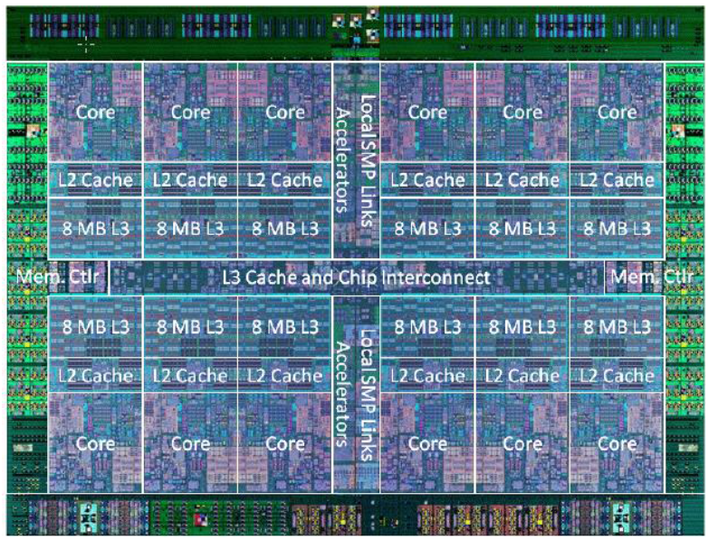
Notes:
S0rd same Logical processor/CPU core thread (SMT)
S1rd same CPU Core
S2rd
S3rd same POWER chip
S4rd same CEC
S5rd other CEC

Slide 52
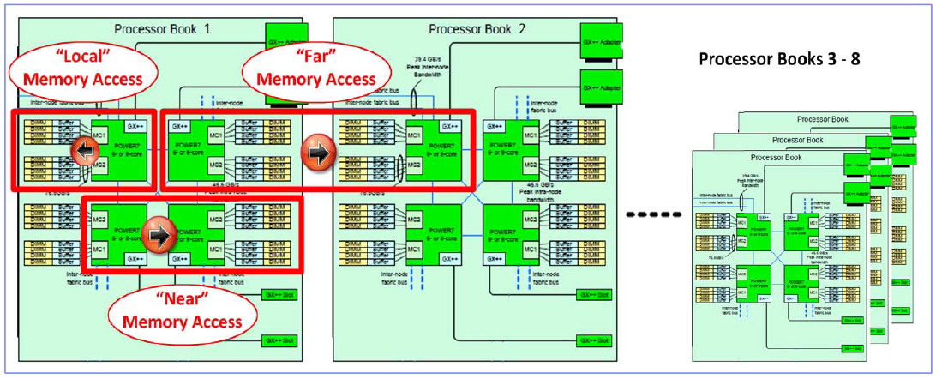
Notes:
S0rd same Logical processor/CPU core thread (SMT)
S1rd same CPU Core
S2rd
S3rd same POWER chip
S4rd same CEC
S5rd other CEC

Slide 53
Downloadable Assistance

Slide 54
VIOS Performance Advisor
Included in O/S since VIOS 2.2.3

Slide 55
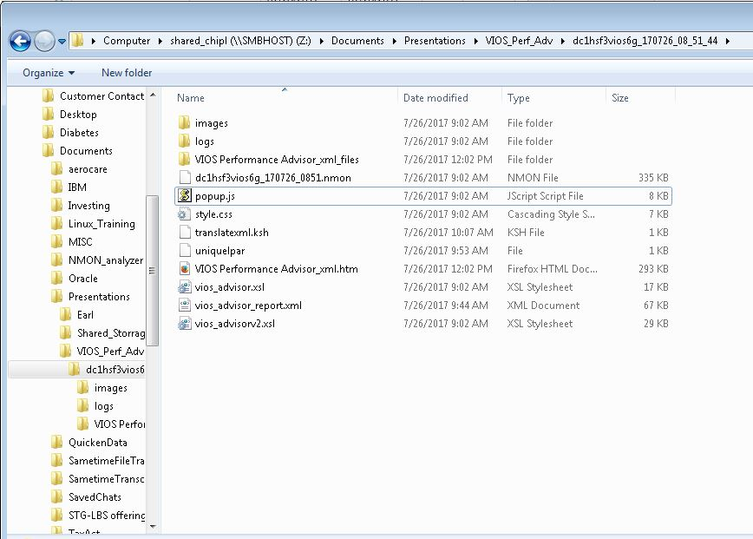
VIOS Performance
Login to VIOS as padmin
Become the root user
$oem_setup_env
Run the part command
Nohup /usr/perf/analysis/part –I 10 –t 2 &
Once complete, download the generated tar file and view on laptop.

Slide 56
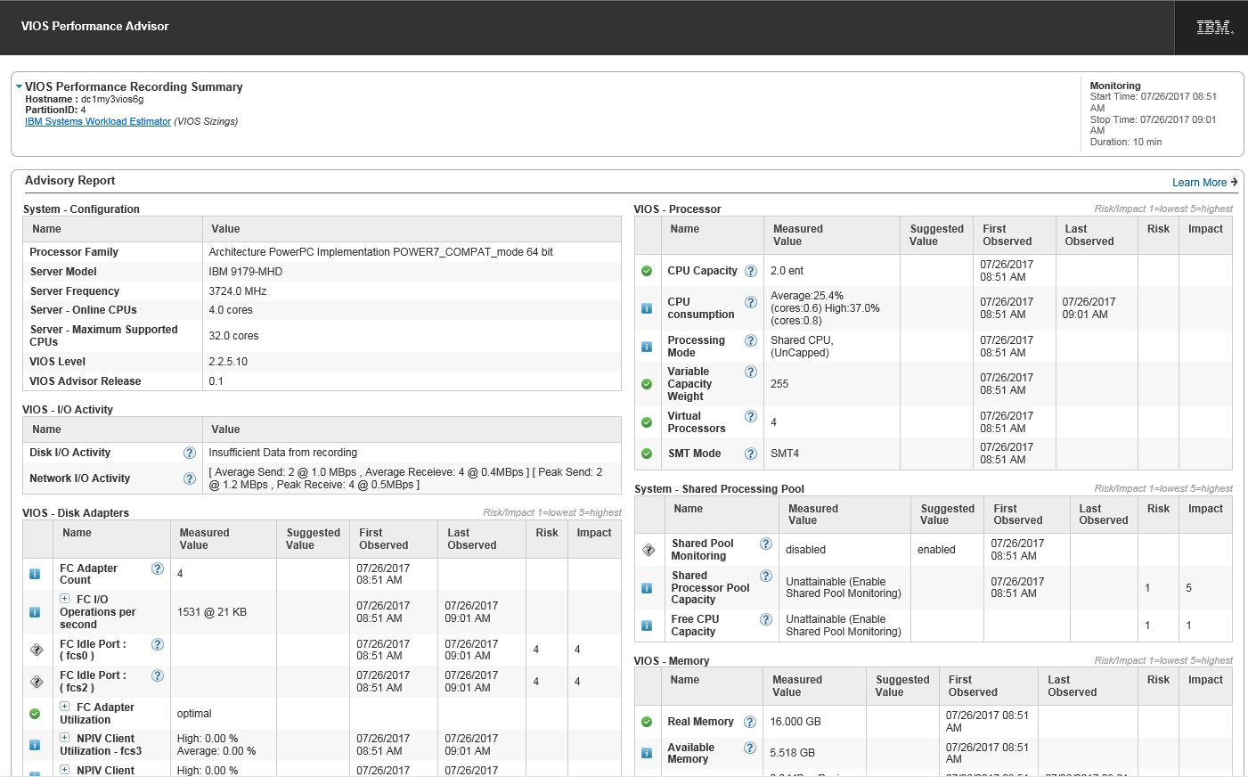
Notes:
Switch to real file here for better demonstation

Slide 57
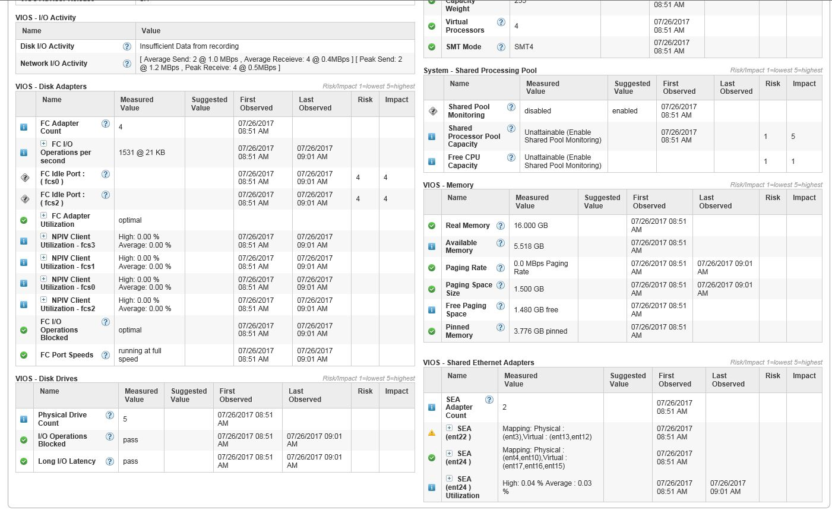

Slide 58
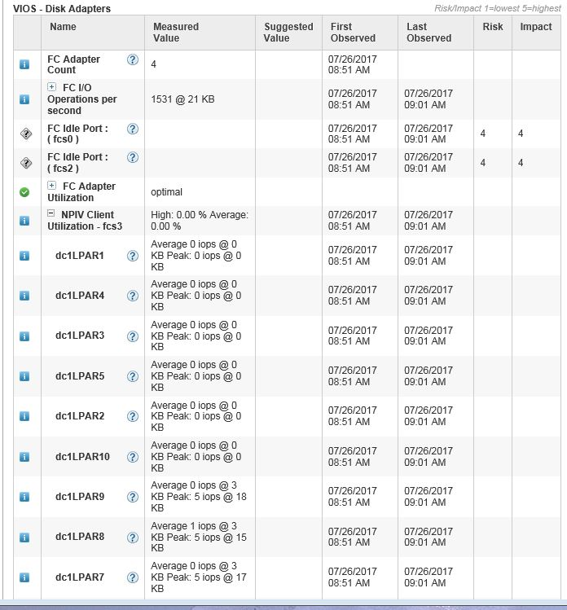

Slide 59
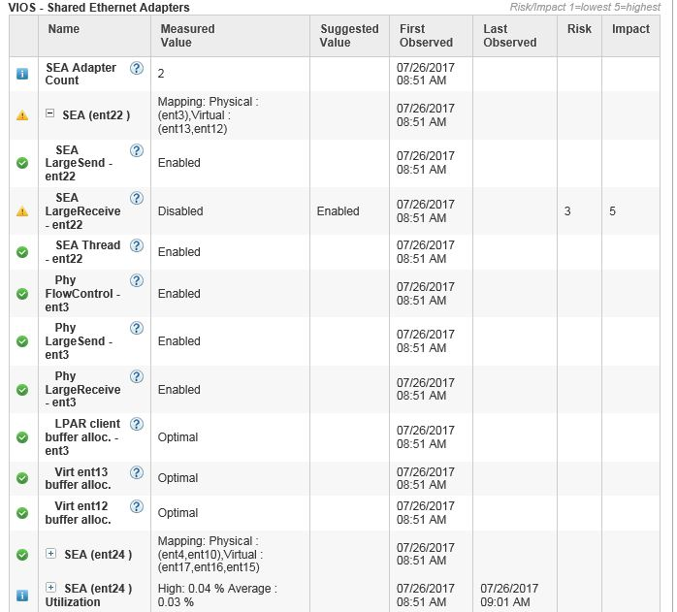

Slide 60
HMCScanner
IBM supported product to view all frames attached to an HMC

Slide 61

HMCScanner
Available from IBM developer works
Runs on AIX or Windows
Requires access to a single HMC

Slide 62
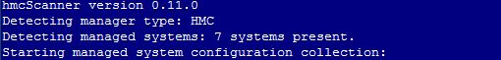
Creating the hmcscanner report

Slide 63
nmon_analyser
IBM supported product to review nmon recordings

Slide 64
# ls -l
total 51456
-rw-r--r-- 1 promon staff 4569283 Jul 21 01:12 dc1profs03p_170720_0001.nmon
-rw-r--r-- 1 promon staff 4007125 Jul 22 00:17 dc1profs03p_170721_0001.nmon
-rw-r--r-- 1 promon staff 2934433 Jul 23 00:20 dc1profs03p_170722_0001.nmon
-rw-r--r-- 1 promon staff 3161855 Jul 24 00:18 dc1profs03p_170723_0001.nmon
-rw-r--r-- 1 promon staff 4115286 Jul 25 00:17 dc1profs03p_170724_0001.nmon
-rw-r--r-- 1 promon staff 4035540 Jul 26 00:17 dc1profs03p_170725_0001.nmon
-rw-r--r-- 1 promon staff 3490763 Jul 26 20:18 dc1profs03p_170726_0001.nmon

Slide 65
crontab -l
01 0 * * * /usr/bin/topas_nmon -xdMALV^ -f
15 0 * * * find $HOME -name "*nmon" -mtime +30 |xargs -I {} rm {}

Slide 66


Slide 67
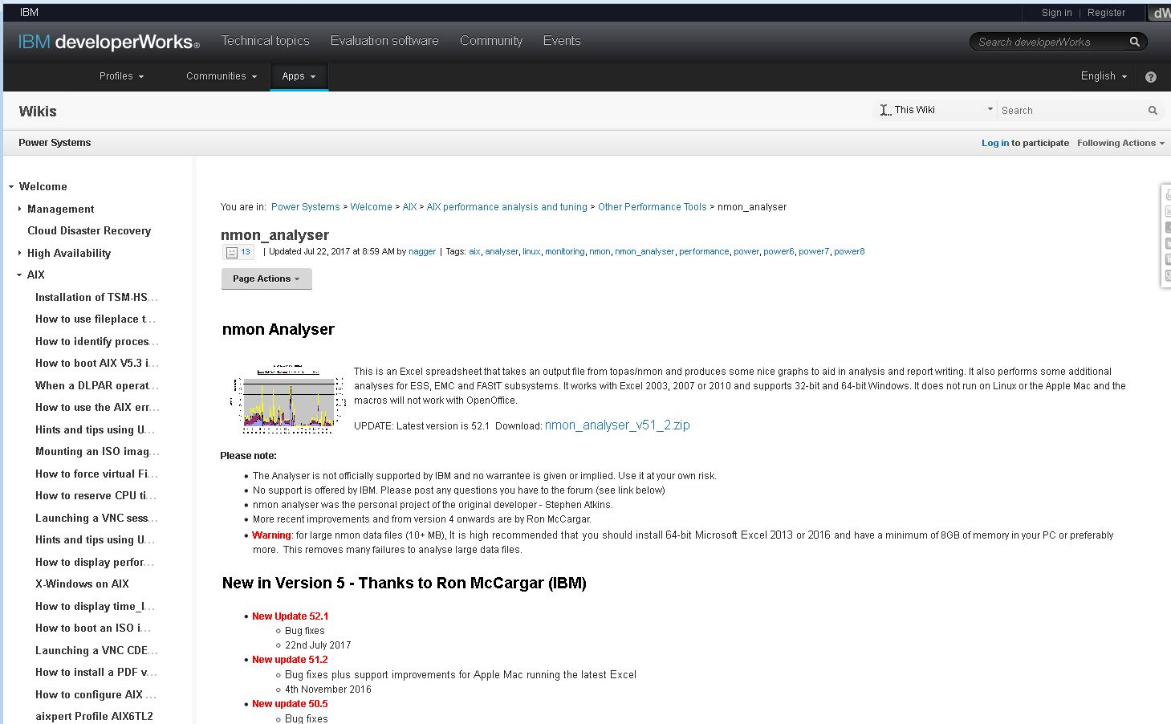

Slide 68
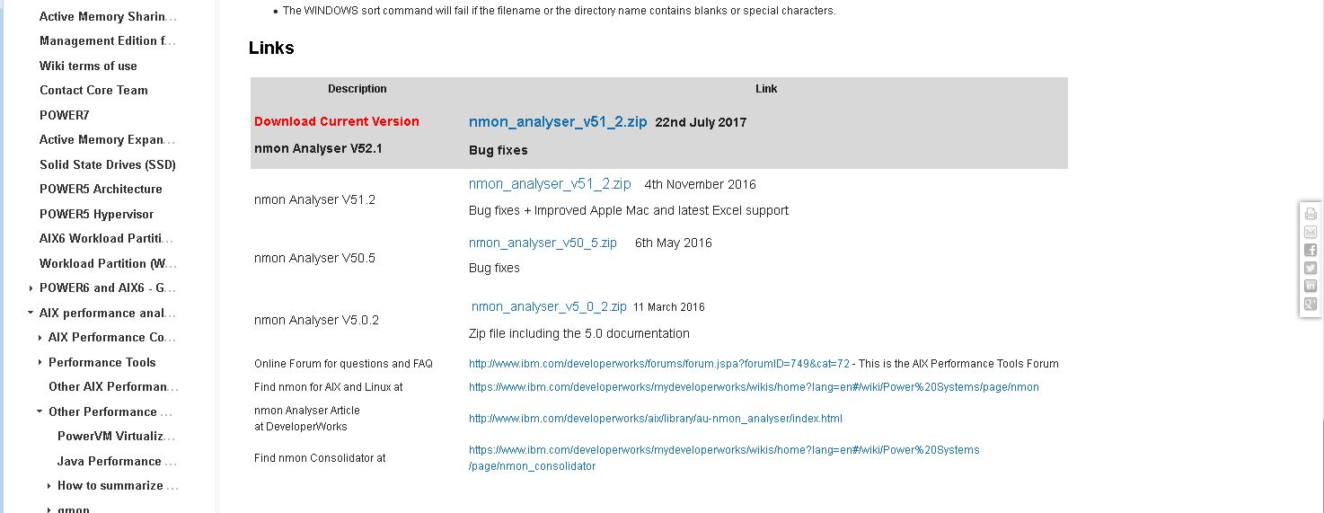

Slide 69
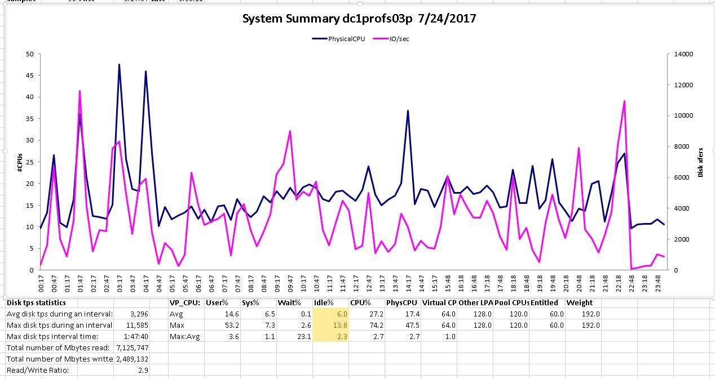

Slide 70
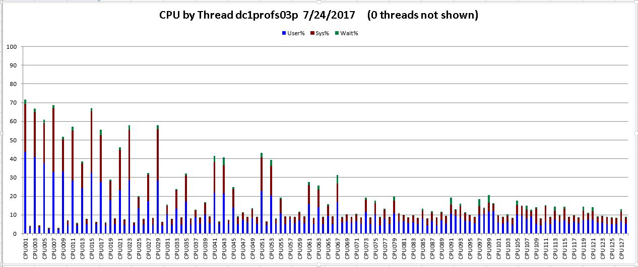

Slide 71
devscan
IBM supported product to collect and view SAN information

Slide 72
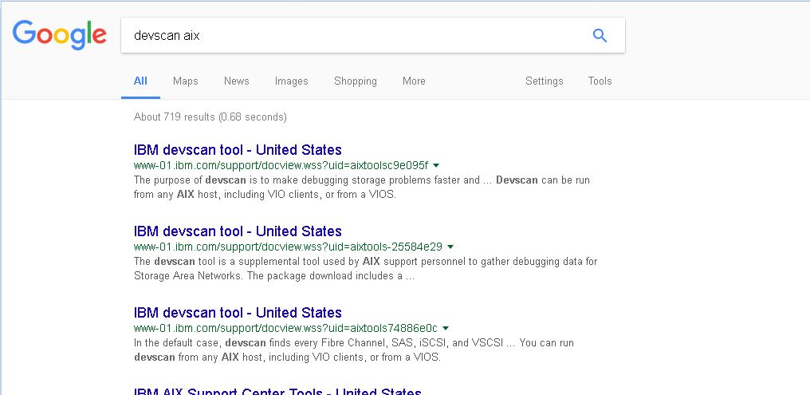
devscan
Command from IBM Support Center
Runs from LPAR or from VIOS
Collects and displays information about connection to storage
Runs as root and generates a text file output

Slide 73
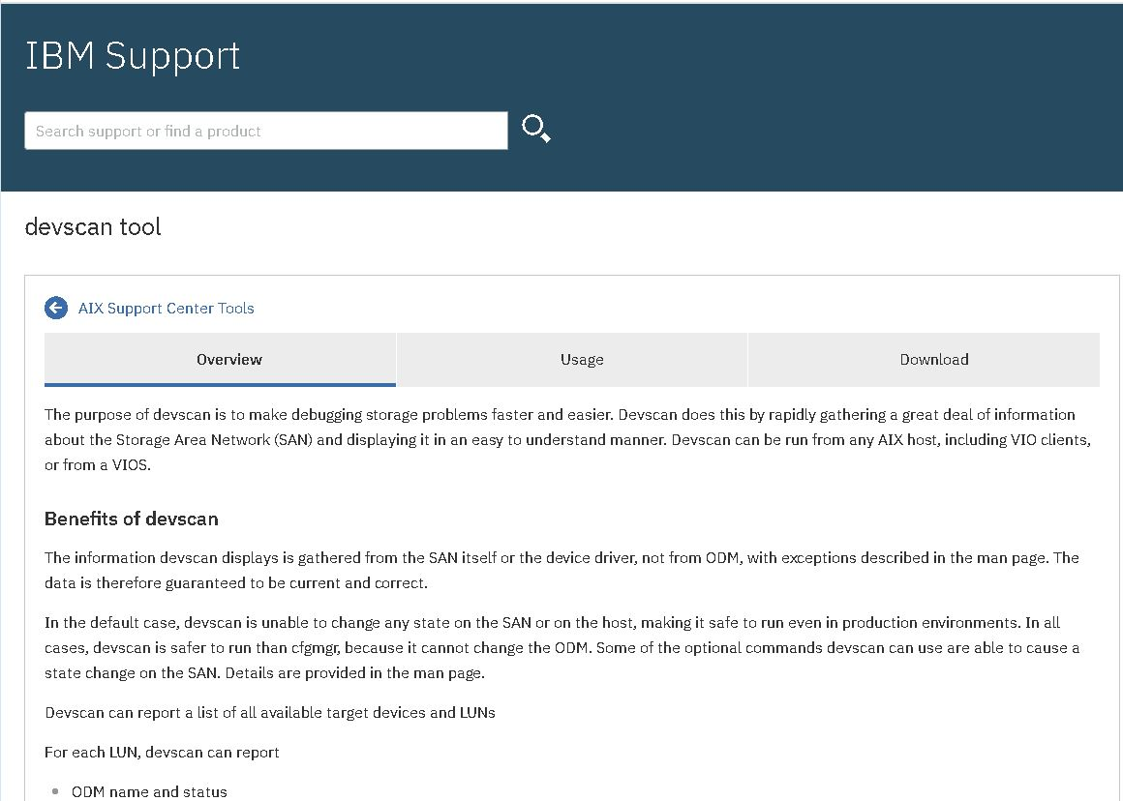
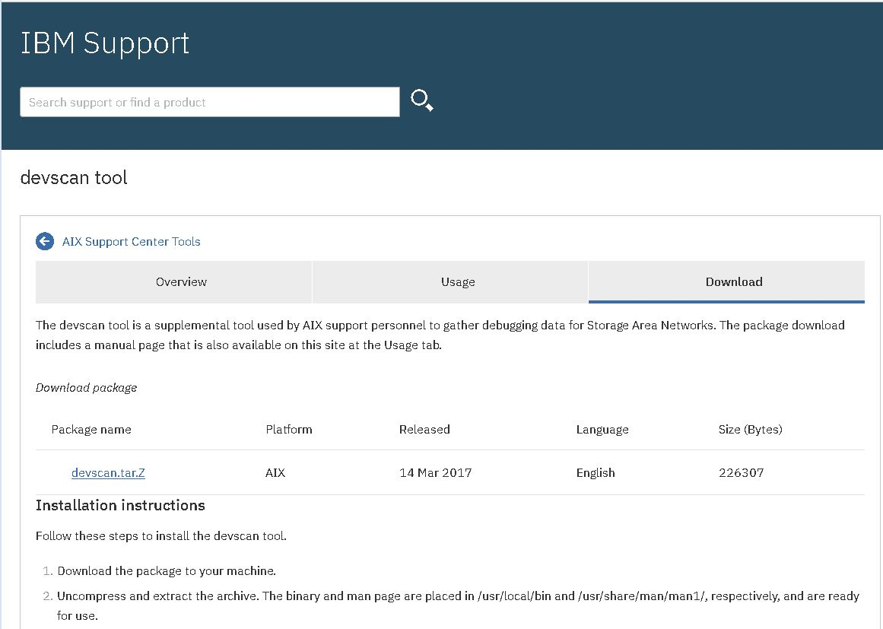
devscan download
Landing page
Download file

Slide 74
devscan
When the download file is expanded you will get a tar file to install on the target system
Use tar –xvf to extract a man page and the command. The files will be placed in /usr/local/bin and /usr/local/man
Enter the devscan command and text file will be crated. Generally this file is uploaded to IBM support but there is no reason for you not to look at it first.

Slide 75
perfpmr
IBM supported product to collect and view performance data

Slide 76

perfpmr
IBM Support Center script used to collect large amounts of data about an LPAR.
Generally run at the request of support to help diagnose performance issues.
Usually installs in /tmp and deleted after incident
The script is installed and run as root.
Requires 10 to 15 minutes to complete and only gathers useful information when a problem is actually ocuring

Slide 77
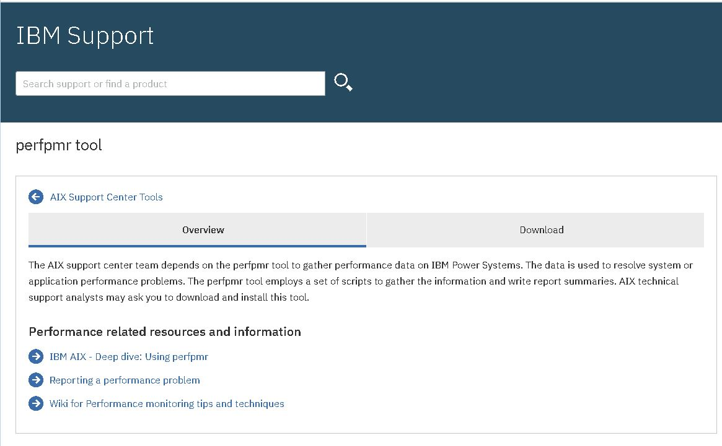
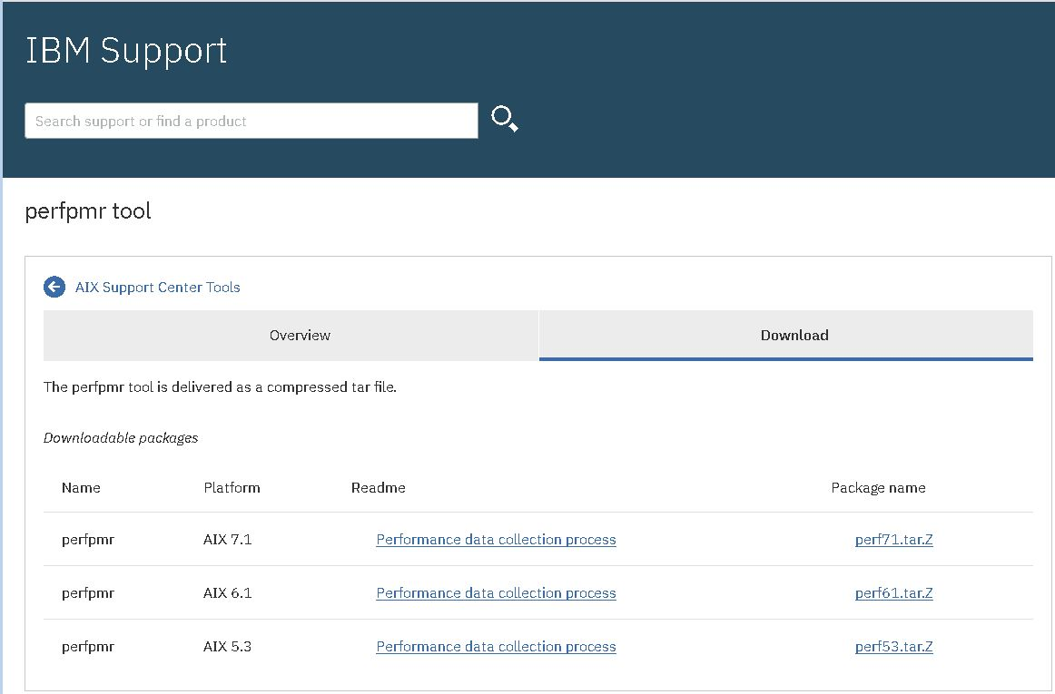
perfpmr

Slide 78
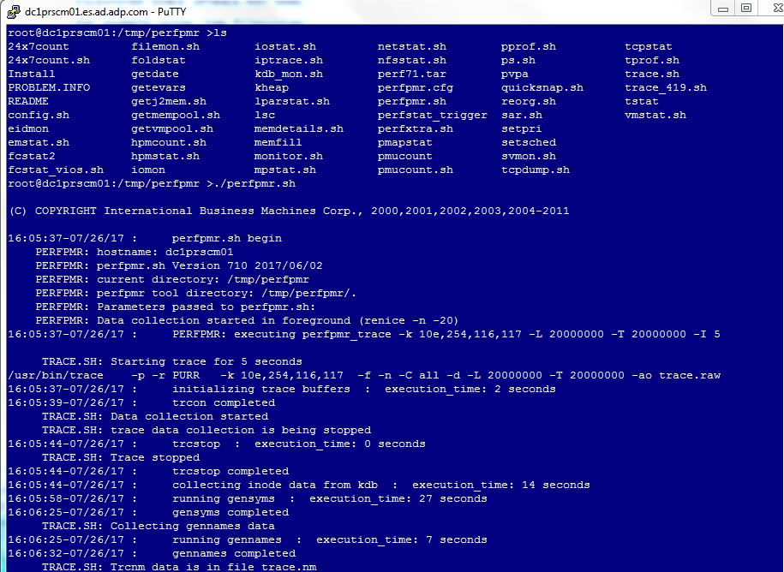
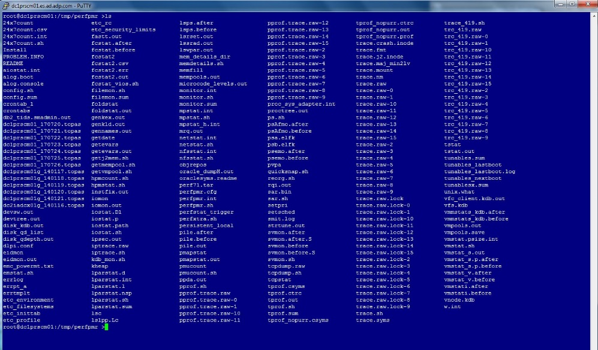
perfpmr

Slide 79
lpar2rrd
Third party product similar to ITM for collecting performance data on the entire environment

Slide 80

lpar2rrd
Client/server third party product to collect performance data on an environment
Requires agents on all LPAR and VIOS.
Not supported by IBM.
Similar to ITM but not as flexible.
Probably simpler to maintain but reported to start having performance issues when LPAR count exceeds several hundred.
Widely used and highly regarded among user community

Slide 81
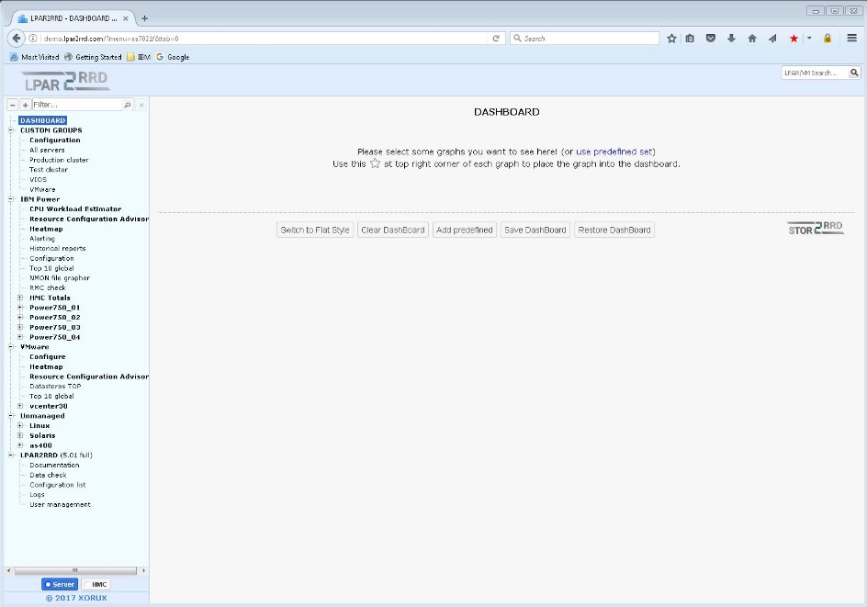
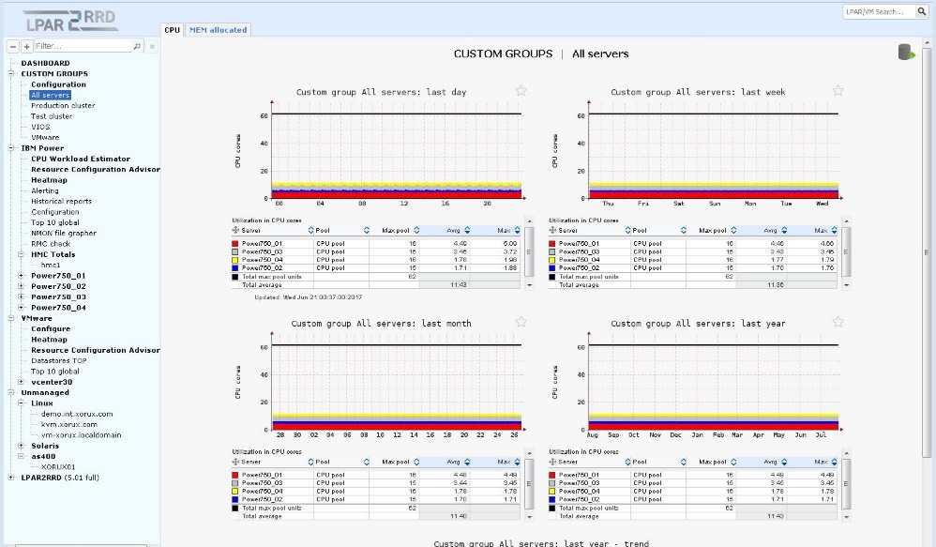
lpar2rrd Web Demo

Slide 82
STG Lab Services tools
Available as Power To Cloud Reward Services

Slide 83
STG Lab Services Engagements
CPT
ProMon
vSCSI2NPIV
Power Enterprise Pools
Capacity Planning Toolkit
Proactve Monitoring Infrastructure
Migrate Storage with no downtime
CPU and Memory capacity deployment and mobility across multiple frames

Slide 84
STG Lab Services Engagements
LPM toolkit
Provisioning Toolkit
ITM
Big Fix
Easily manage Frame evacuation for maintenance or load rebalancing
Go from empty frame to dual VIOS and 100 operating LPAR in a morning
Enterprise sized tool for monitoring capacity utilization and performance on Frame, Group and LPAR level
Enterprise software maintenance product for AIX and other standard software

Slide 85
Capacity Planning Tool
STG Lab Services supported tool to right size your environment

Slide 86
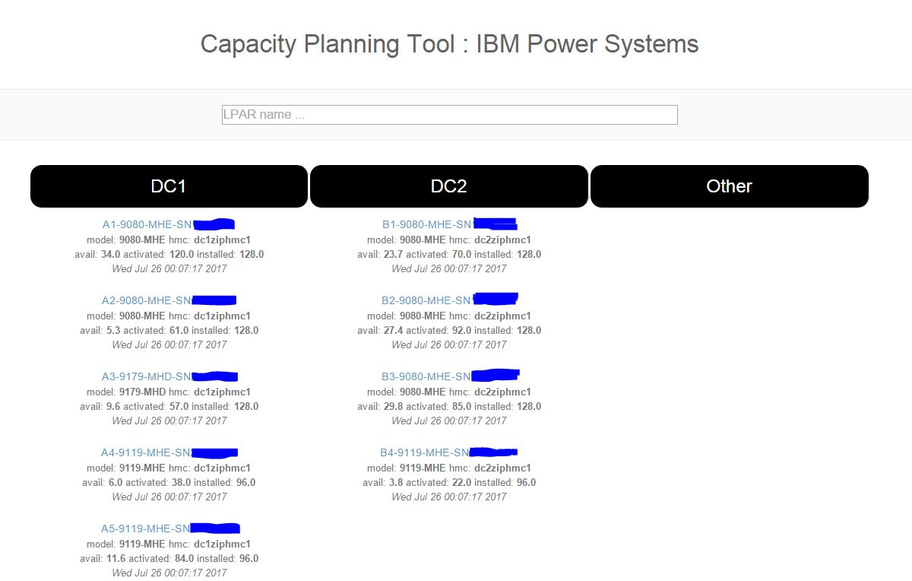

Slide 87
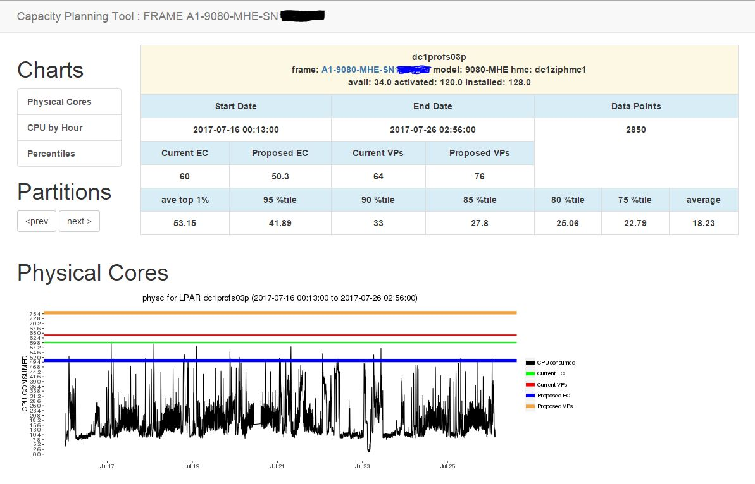

Slide 88
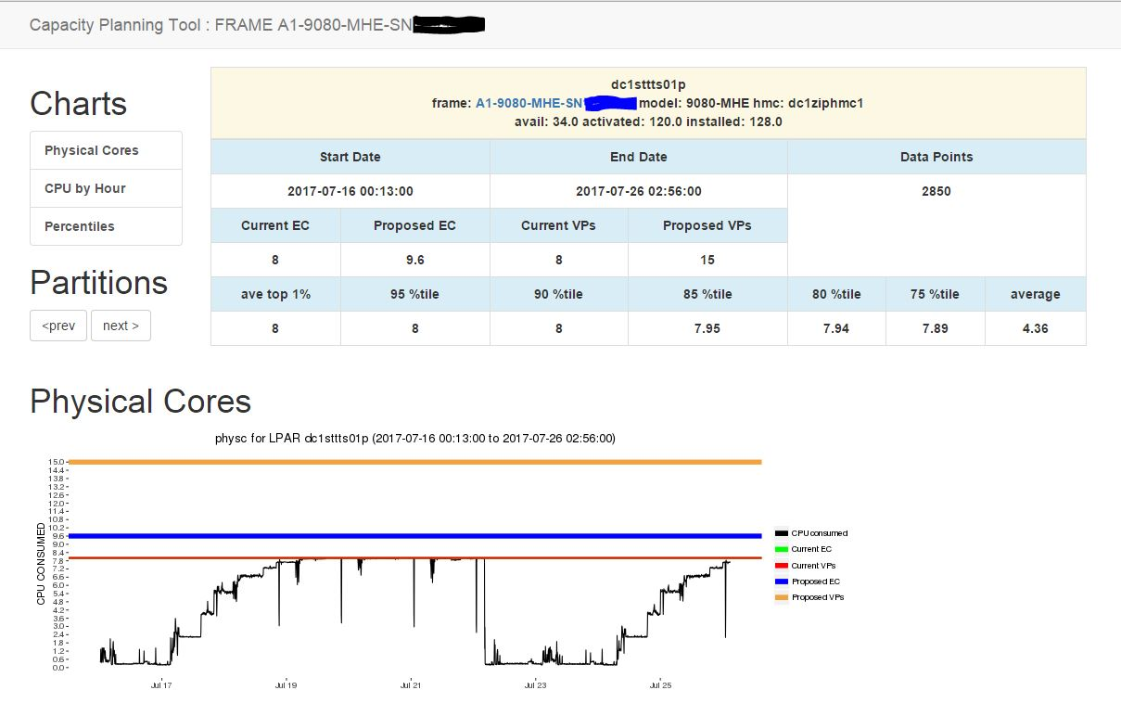

Slide 89
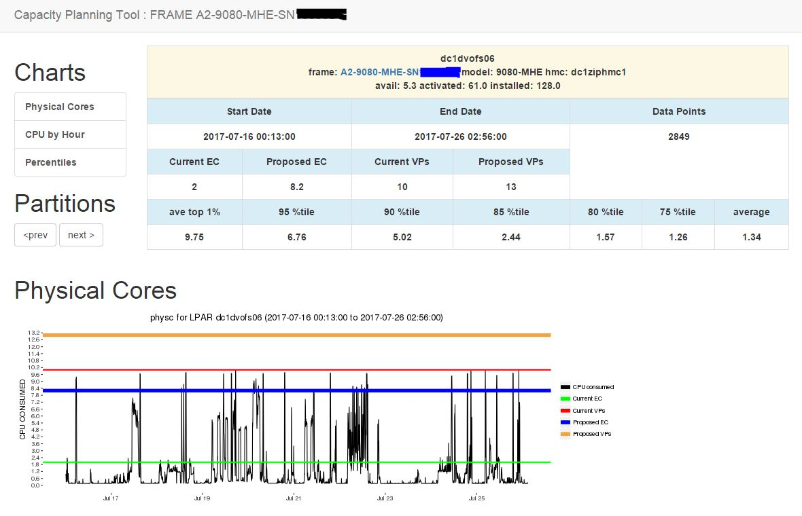

Slide 90
Proactive Monitoring Infrastructure
STG Lab Services supported tool to alert you to potential issues before your users notice a problem

Slide 91

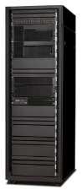
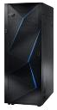
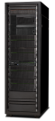
ProMon
Definition of terms
•Critical Monitoring
•Events
•Outages
•Strategic Monitoring
•Utilization
•Redundancy
•Standardization
POWER7+
Notes:
91

Slide 92
Murphy’s Law
Another way of stating things
•The second law of thermodynamics states that the entropy of any isolated system always increases.
•Murphy’s Law
“If anything can go wrong, it will” (1)
•O’Toole’s Commentary on Murphy’s Law
“Murphy was an optimist” (2)
Murphy’s Law and other reasons why things go wrong! By Arthur Bloch 1977 p11
Murphy’s Law and other reasons why things go wrong! By Arthur Bloch 1977 p12
Notes:
92

Slide 93
ProMon Sample LPAR Report
LPAR Status Report Jul 21 2016 at 02:01:00 AM Processing HMC unxhmcpa002 Collecting LPAR list from HMC unxhmcpa002 Processing HMC unxhmcpa003 Collecting LPAR list from HMC unxhmcpa003 Processing Frame florida Processing Frame mississippi
lpar001-NoLPM, Unable to audit LPAR due to failure of ssh
… lpar2, Check rootvg on lpar2 for closed/stale partitions lpar2, MPIO policy error. Fewer than 4 path to disk hdisk0 lpar2, MPIO policy error. Fewer than 4 path to disk hdisk1 lpar2, Shortage of DMA Resources found for fcs2 lpar2, Consider changing command elements on fcs2 from 500 to 1024 lpar2, Consider changing transfer size on fcs2 from 0x100000 to 0x200000 lpar2, OS inconsistencies found on lpar2
…. lpar3, Check rootvg on lpar3 for closed/stale partitions lpar3, Health Check interval policy error on hdisk12 lpar3, Queue depth policy error for hdisk12 lpar3, Health Check interval policy error on hdisk13 lpar3, Queue depth policy error for hdisk13
…. lpar4, TSM may not be running fcs and vscsi adapters both exist on lpar4
….. lpar5, Check rootvg on lpar5 for closed/stale partitions lpar5, Reserve lock set to yes for hdiskpower0 lpar5, Reserve lock set to yes for hdiskpower2 lpar5, Reserve lock set to yes for hdiskpower3 lpar5, Reserve lock set to yes for hdiskpower4 lpar5, Shortage of DMA Resources found for fcs0 lpar5, Consider changing command elements on fcs0 from 500 to 1024 lpar5, Consider changing transfer size on fcs0 from 0x100000 to 0x200000 …… A total of 253 LPAR were audited Errors were found in 206 LPAR or 81 %

Slide 94
ProMon Sample VIOS report
Starting VIOS audits at 0201 on 072116 florida-vio2 There is/are 4 configured Shared Ethernet Adapters on florida-vio2 functioning normally florida-vio2 For ent12 there were 0 MB sent and 1454 MB received with 0 xmit errors and 0 receive errors florida-vio2 Maximum Transmit Queue was 0 packets with no overflow errors florida-vio2 For ent20 there were 0 MB sent and 26 MB received with 0 xmit errors and 0 receive errors florida-vio2 Maximum Transmit Queue was 0 packets with no overflow errors florida-vio2, For ent32 there were 9096 MB sent and 10124 MB received with 18922929 xmit errors and 568 receive errors florida-vio2 Maximum Transmit Queue was 4 packets with no overflow errors florida-vio2, Dynamic tracking not set on fscsi0 florida-vio2, Fast_Fail attribute not set on fscsi0 florida-vio2, Dynamic tracking not set on fscsi7 florida-vio2, Fast_Fail attribute not set on fscsi7 florida-vio2, Check for failed adapter in SEA ent16 florida-vio2, Unmirrored LV found rootvg audit_lv jfs2 /audit
florida-vio1 There is/are 4 configured Shared Ethernet Adapters on florida-vio1 functioning normally florida-vio1, For ent32 there were 0 MB sent and 1218 MB received with 0 xmit errors and 568 receive errors
VIOS audits complete at 0222 on 072116
Notes:
94

Slide 95
Continuing your education
Nigel Griffiths AIXpert
https://www.ibm.com/developerworks/community/blogs/aixpert?lang=en
Chris’s AIX Blog
https://www.ibm.com/developerworks/community/blogs/cgaix?lang=en
Earl Jew
http://www.ibmsystemsmag.com/aix/administrator/performance/CPU-Threading-Efficiency/

Slide 96
Thank you for your attention

